Slide 1
MOVING AGE
Trieste 2016
The vision, mission, strategy and action plans in Flanders

Slide 2
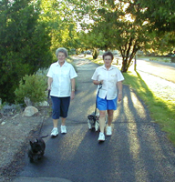
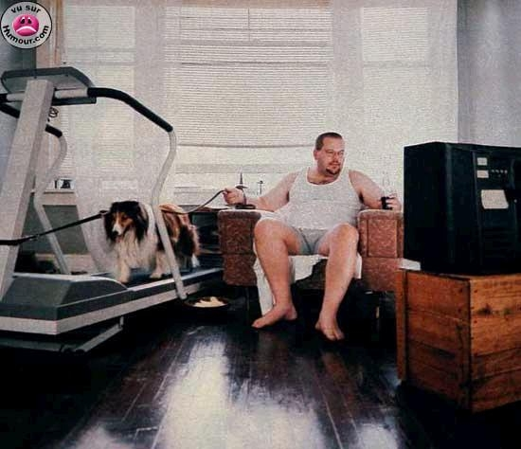
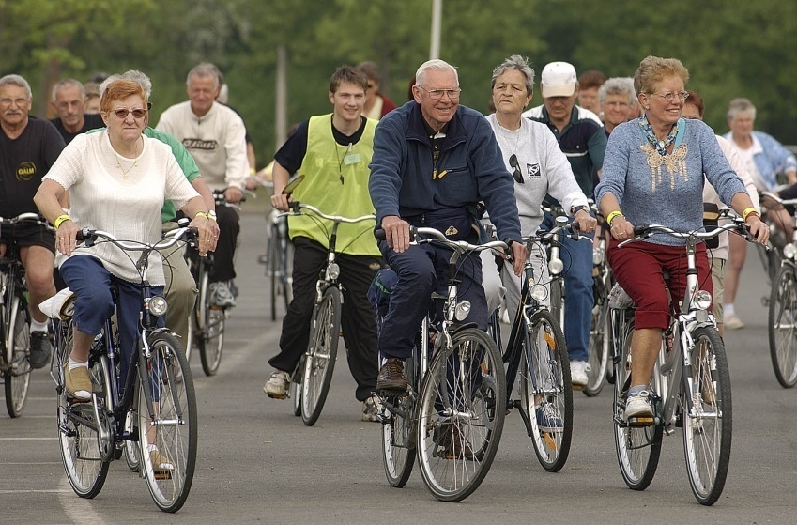
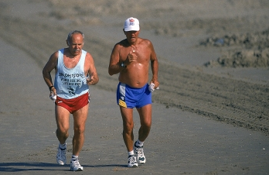
Seniors, a diverse group!

Slide 3

Physical Inactive
Not aware of the importance
Often oldest elderly people:
  No participation chances in the past!
  Image: retire = rest
Difficult but important group!

Slide 4

Physical active in daily activities
Functional
Alone or with partner or a friend
Risk: change in their life can lead to inactivity!

Slide 5
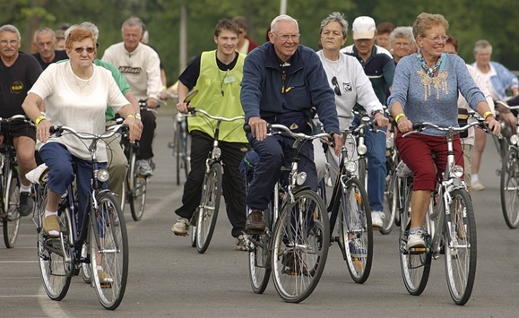
Joining sportactivities
OKRA: elderly organization
1.100 local clubs: organizing all kinds of activities: daytrips – card playing – academies …
930 clubs
OKRA-SPORT: sportfederation
Stimulating and facilitating organizing sportactivities: cycling – hiking – gym – dance …

Slide 6
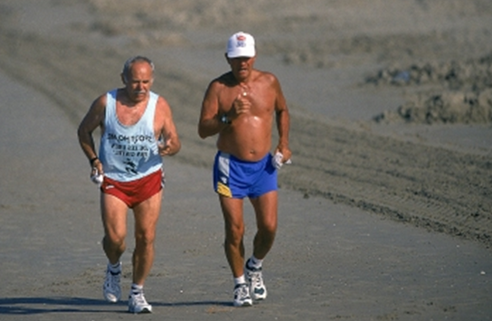
Life time sporters
Very motivated!
In clubs or individual

Slide 7
A diverse group → a diverse approach
How to reach and motivate them
Programs
Providers and partners

Slide 8
How to reach and motivate them
Personal approach
Easy talk coming slowly to the message
Importance of peer education

Slide 9
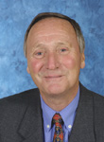
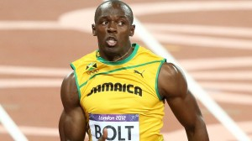
How to reach and motivate them
Importance of peer education!

Slide 10
How to reach and motivate them
Inviting them to join an event
Convince them that joining sport activities in group has an extra dimension

Slide 11
How to reach and motivate them
They are allready motivated!
Keep them interested by organising varieties in activities

Slide 12

How to reach and motivate them
Very motivated
Ask them to be a trainer or supervisor of sportactivities for their peers.

Slide 13
Programs
Concrete projects:
  Individual starting point
  Personal program during a well defined period
  In a social setting guided by peers
  Personal goal

Slide 14


Concrete projects

Slide 15

Programs
Events with low barrier activities

Slide 16
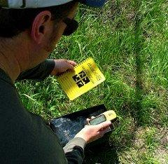
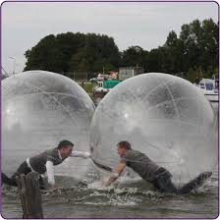
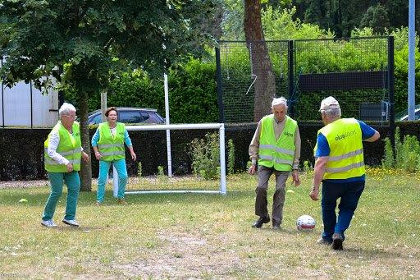
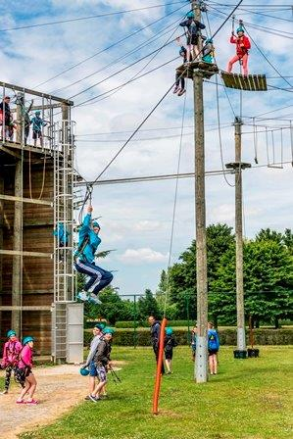

Slide 17
Programs
Challenging activities
Competition
Education to be a trainer or supervisor for sportactivities for their peers

Slide 18
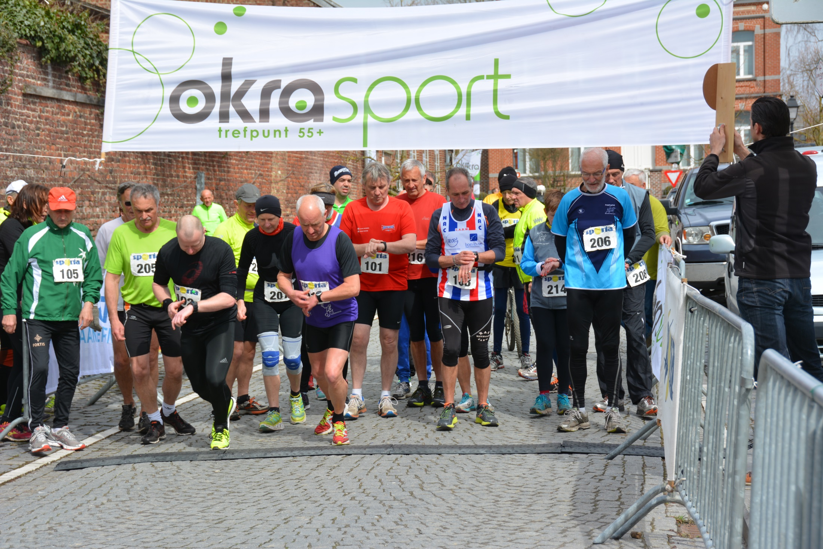

Slide 19

Providers and partners
Work together with health providers
Work together with
elderly organisations

Slide 20
Providers and partners
Keep them in your club!
Adapt your activities

Slide 21
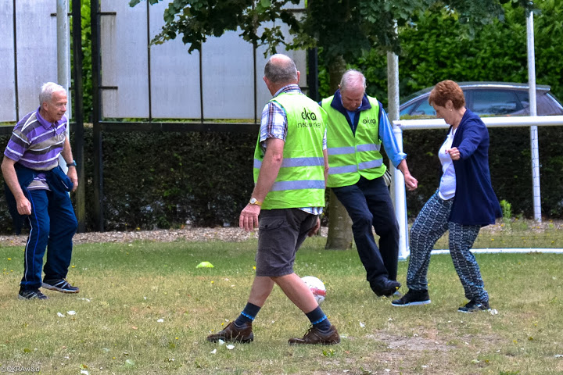
Adapt your activities

Slide 22
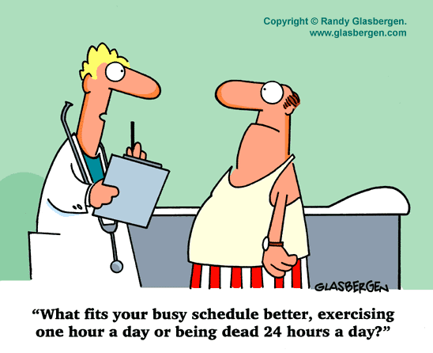
THANKS FOR YOUR ATTENTION

