Slide 1
Keeping the elderly active
Ideas – beliefs - challenges

Slide 2
Ideas and beliefs
Concrete projects:
Individual starting point
Personal program during a well defined period
In a social setting guided by peers
Personal goal

Slide 3
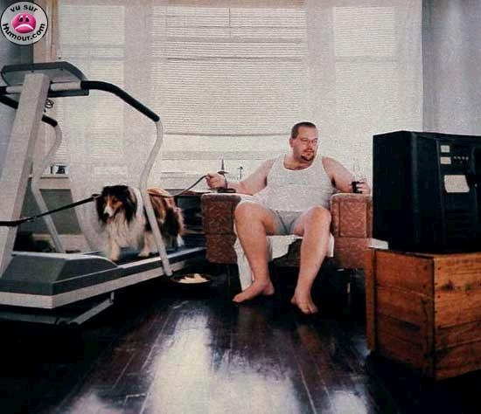
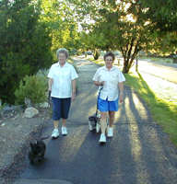

Slide 4
Ideas and beliefs
How? Thinking ‘out of the box’!

Slide 5
Ideas and beliefs
Coming to new challenging settings
Move Transfer:
Every step
counts in
prison

Slide 6
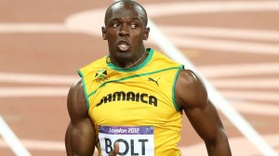
Challenges
How to motivate inactive elderly people?
Importance of peer education!

Slide 7
Challenges
From ‘mustivation’ to motivation
Education of ambassadors of Movement
Method ABC
Autonomy
Belonging
Competence

Slide 8
Challenges
Developing new projects together with experts and volunteers
Exchanging experiences with other organisations in Europe → Moving Age Platform

Slide 9
THANKS FOR YOUR ATTENTION

