Slide 1
How to stimulate physical activity and excercise

Slide 2
FACT
Research has shown that more than half of the 55-plussers haven’t enough physical activity te be healty and to age actively.

Slide 3
EVERY STEP COUNTS: WHAT?
Sensibilisationcampaign that encourgages to have more physical activity.
walking → pedometer
Personal goal in 10 weeks
→ health benefits
Trainingschedules by KULeuven
Community project

Slide 4
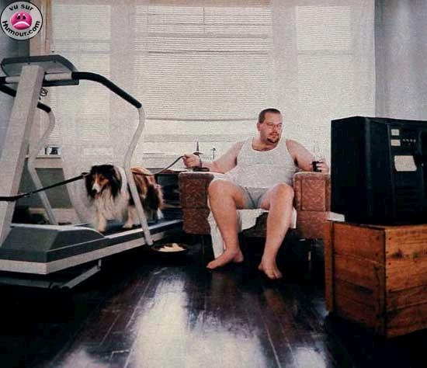
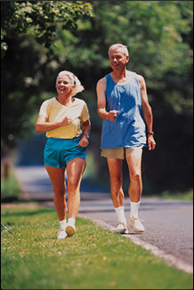
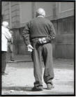
TARGET GROUP?
3
2
4
4

Slide 5
APPROACH
PEEREDUCATION
LOCAL IMPLEMENTATION
TRAIN THE TRAINER:
The importance of physical exercise
Technical education
‘It is OK to infect the others’

Slide 6
RESULTS NUMBERS
Every step counts
394 participating clubs
20 residential care centers
7000 participants of which 2000 sedetary people

Slide 7
RESULTS
Week 1 (september-oktober)
29 trefpunten – 432 deelnemers
10 trefpunten – 148 deelnemers
Interventie-periode
Elke stap telt!
Geen interventie
Week 10 (november-december)
359 deelnemers
113 deelnemers

Slide 8
RESULTS

Slide 9
RESULTS EXERCISE

Slide 10
RESULTS FITNESS -TEST

Slide 11
RESULTS CONSENT
FEAR
HEALTH
F = 5,26, p < .05
F = 3,96, p < .05

Slide 12
SUCCESFACTORS
Working with a scientifically based program.
Involvement of volunteers from the start.
Local implementation
Peer-education
F = 6.19, p < .05

Slide 13
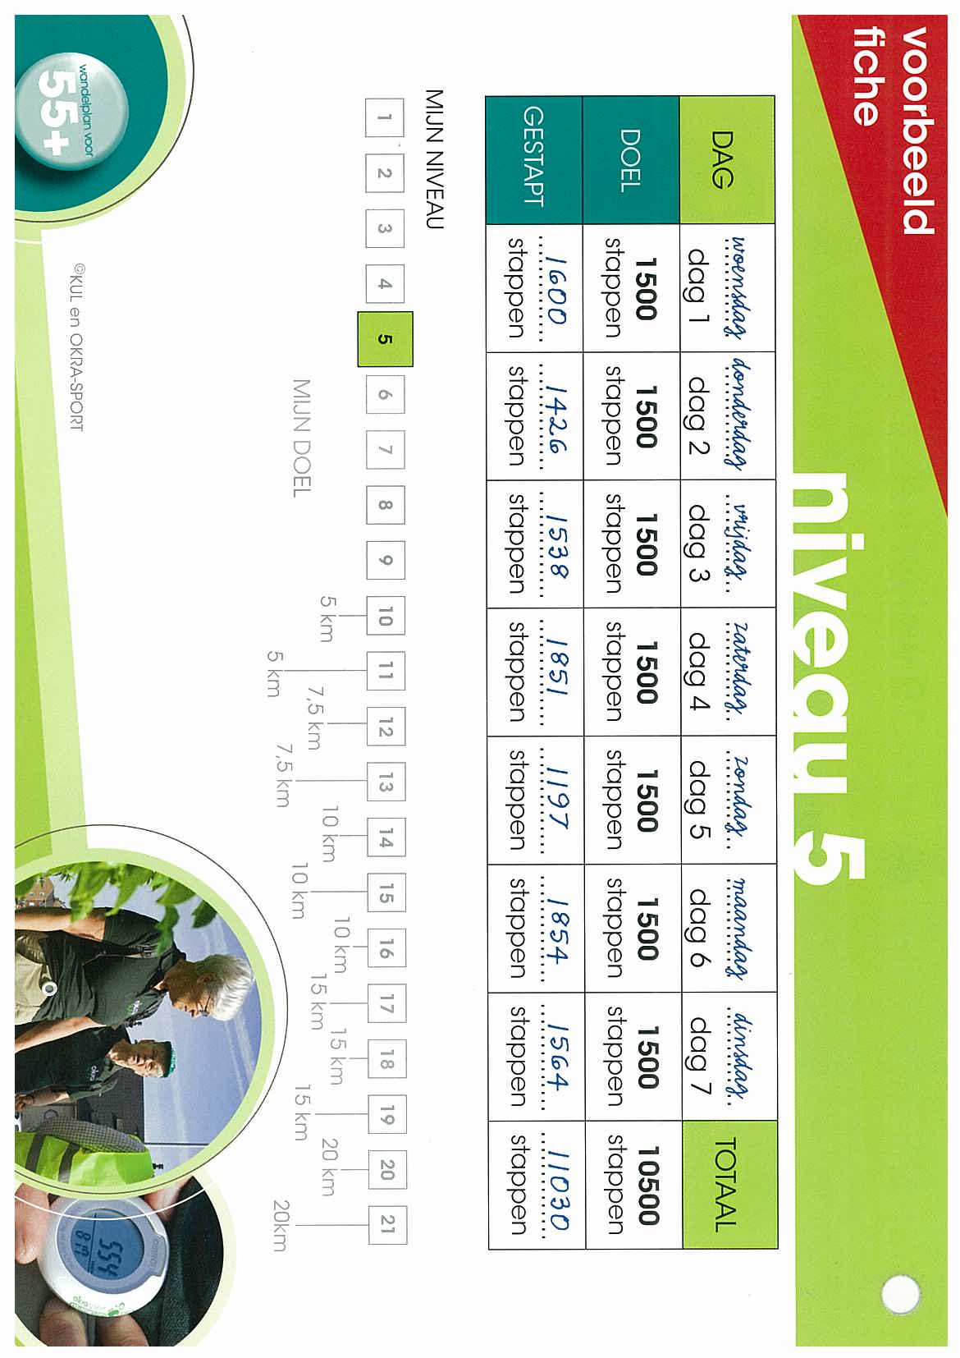
SUCCESFACTORS
We realize this together: social control and social contact
Solid and beautiful elaborated material
Anchoring ensured
Cooperation with partners: KULeuven, VIGeZ, Familiehulp DVV, …

Slide 14
CONTINUATION
SportZeeland (2012)
10 cities
350 participants
In prison (2013)
PortaAL
Cities can enroll in the project ‘Every stp counts’

Slide 15
CONTINUATION
EVERY KICK COUNTS (2011 – 2012)
Same model
With attention for the sedentary people
Program for hometrainer
Possibillity for rent / buy an elektrical bike
3671 participants (928 sedentary people)
122 clubs
46 residential care
center

Slide 16
THANKS FOR YOUR ATTENTION!

